Slide 1
Electrifying the Building Sector in the PJM Footprint
Susan Coakley, Executive Director
December 18, 2019

Slide 2
Northeast Energy Efficiency Partnerships
“Assist the Northeast and Mid-Atlantic region to reduce building sector energy consumption 3% per year and carbon emissions 40% by 2030 (relative to 2001)”
Mission
We seek to accelerate regional collaboration to promote advanced energy efficiency and related solutions in homes, buildings, industry, and communities.
Vision
We envision the region's homes, buildings, and communities transformed into efficient, affordable, low-carbon, resilient places to live, work, and play.
Approach
Drive market transformation regionally by fostering collaboration and innovation, developing tools, and disseminating knowledge
One of six Regional Energy Efficiency Organizations (REEOs) funded in-part by U.S. DOE to support state and local efficiency policies and programs.

Slide 3
Building Decarbonization ➔ 3 Key Elements
Advanced Electric Technologies
Deep Energy
Efficiency
Grid
Integration
Space/Water
Heating – Heat Pumps
Thermal
Improvements
Flexible use of
Low-Carbon Electricity
Northeast Strategic Electrification Action Plan – NEEP 2018
Notes:
In that regional opportunity assessment, assisted by Synapse Energy Economics and Meister Consulting (now Cadmus), we found that switching to advanced heat pumps for space and water heating from burning fossil fuels is a major opportunity to increase energy efficiency and reduce carbon emissions. To maximize the economic benefits of this strategic electrification, we identified three key elements:
The need to catalyze the broad market adoption of advanced heat pump technology that performs efficiently even in very cold temperatures.
Adopt qualtiy

Slide 4
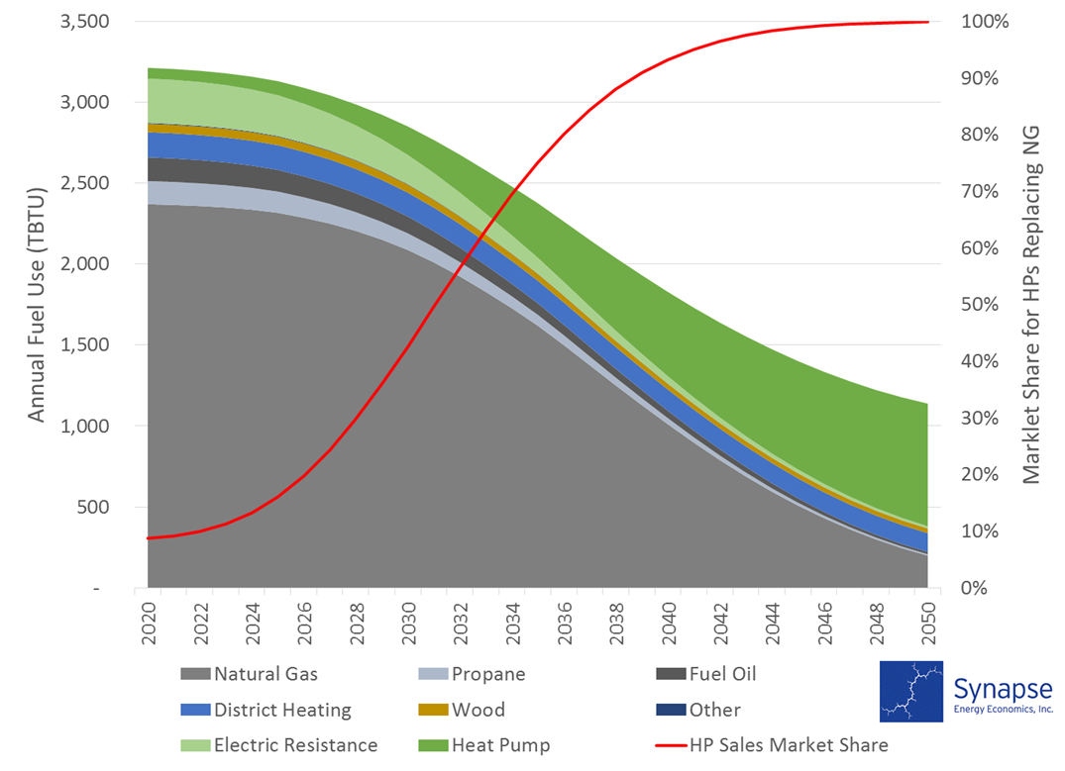
Advanced Heat Pumps Market Adoption in Natural Market Cycles Reduces Building Energy Use in PJM States
Advanced Heat Pump Impacts on Building Energy Use In PJM States by 2050
Advanced heat pump market adoption curve
ASHP as 100% of heating equipment sales by 2045 for space and water heating in PJM states by 2050:
Reduces total building energy use in homes & buildings by 60%
Reduces building fossil fuel use to a small fraction
Slightly increases electricity use
Reduced TBTU for homes and buildings
Increased electricity use
Reduced fossil fuels for heating and cooling

Slide 5
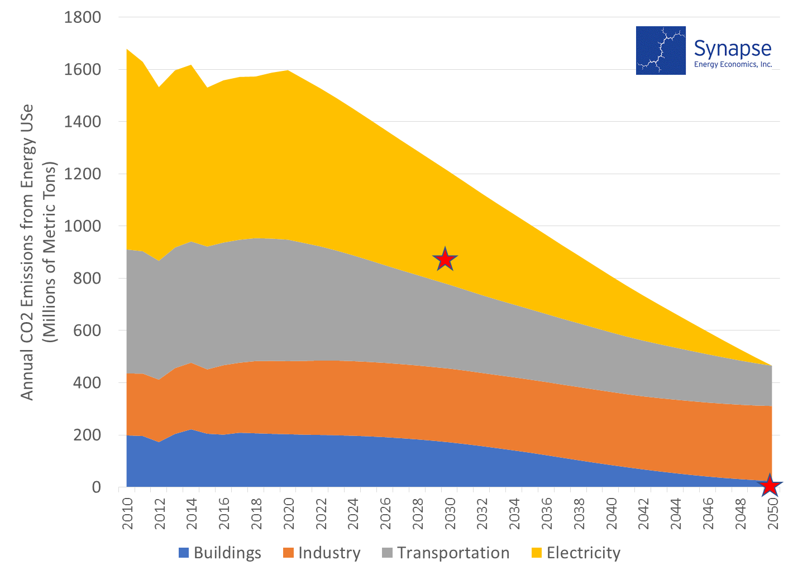
Carbon-Free Powered Advanced Heat Pumps Puts 2050 Climate Stabilization Goals In Reach within PJM States
Greenhouse Gas Emissions Impact of Building & Transportation Electrification in PJM States by 2050
Power Generation: 100% Carbon Free by 2050
GHG Emissions 45% below 2010 in 2030
Transportation: Broad Adoption of Light Duty Electric Vehicles
Industrial: Solutions TBD
GHG Emissions 0% by 2050
Buildings: Broad Adoption of Advanced Heat Pumps

Slide 6
Advanced Heat Pumps Are Cost Competitive with Natural Gas Heating in PJM States Today

Slide 7
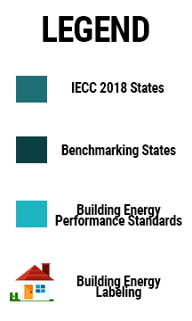
2019: Building Energy Efficiency Policies in PJM States
Building Energy Policy Analysis by NEEP PJM States Map from Duke Nicholas Institute

Slide 8
For More Information :
Carolyn Sarno Goldthwaite
Director of Building and Community Solutions
cgoldthwaite@neep.org
Sue Coakley
Executive Director
NEEP
scoakley@neep.org
Dave Lis
Director of Technology and Market Solutions
NEEP
djlis@neep.org
At www.neep.org:
Building Decarb Central
NEEP Air Source Heat Pump Resource Center
Resilient High Performance Communities

